Slide 1
INTRODUCTION TO JAVA
PRESENTED BY S.R.ZAMEER

Slide 2
What is Java?
Java is a programming language and a platform.
Java is a high level, robust, secured and object-oriented programming language.
Platform: Any hardware or software environment in which a program runs, is known as a platform. Since Java has its own runtime environment (JRE) and API, it is called platform.

Slide 3
Where it is used?
According to Sun, 3 billion devices run java. There are many devices where java is currently used. Some of them are as follows:-
Desktop Applications such as acrobat reader, media player, antivirus etc.
Web Applications such as irctc.co.in, javatpoint.com etc.
Enterprise Applications such as banking applications.
Mobile
Embedded System
Smart Card
Robotics
Games etc.

Slide 4
Types of Java Applications
There are mainly 4 type of applications that can be created using java programming:
Standalone Application
Web Application
Enterprise Application
Mobile Application

Slide 5
1) Standalone Application
It is also known as desktop application or window-based application. An application that we need to install on every machine such as media player, antivirus etc. AWT and Swing are used in java for creating standalone applications.

Slide 6
2) Web Application
An application that runs on the server side and creates dynamic page, is called web application. Currently, servlet, jsp, struts, jsf etc. technologies are used for creating web applications in java.

Slide 7
3) Enterprise Application
An application that is distributed in nature, such as banking applications etc. It has the advantage of high level security, load balancing and clustering. In java, EJB is used for creating enterprise applications.

Slide 8
4) Mobile Application
An application that is created for mobile devices. Currently Android and Java ME are used for creating mobile applications.

Slide 9
History of Java
The history of java starts from Green Team. Java team members (also known as Green Team), initiated a revolutionary task to develop a language for digital devices such as set-top boxes, televisions etc.
For the green team members, it was an advance concept at that time. But, it was suited for internet programming. Later, Java technology as incorporated by Netscape.
Currently, Java is used in internet programming, mobile devices, games, e-business solutions etc.

Slide 10
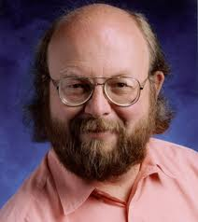
Contd….
1) James Gosling initiated the Java language project in June 1991.
2) Originally designed for small, embedded systems in electronic appliances like set-top boxes.
3) Firstly, it was called "Green talk" by James Gosling and file extension was .gt.
4) After that, it was called Oak and was developed as a part of the Green project.

Slide 11
Why Oak name for java language?
5) Why Oak? Oak is a symbol of strength and chosen as a national tree of many countries like U.S.A., France, Germany, Romania etc.
6) In 1995, Oak was renamed as "Java" because it was already a trademark by Oak Technologies.
7) Originally developed by James Gosling at Sun Microsystems (which is now a subsidiary of Oracle Corporation) and released in 1995.

Slide 12
Java Version History
There are many java versions that has been released. Current stable release of Java is Java SE 8.
JDK Alpha and Beta (1995)
JDK 1.0 (23rd Jan, 1996)
JDK 1.1 (19th Feb, 1997)
J2SE 1.2 (8th Dec, 1998)
J2SE 1.3 (8th May, 2000)
J2SE 1.4 (6th Feb, 2002)
J2SE 5.0 (30th Sep, 2004)
Java SE 6 (11th Dec, 2006)
Java SE 7 (28th July, 2011)
Java SE 8 (18th March, 2014)

Slide 13
Features of Java
The Java Features given below are simple and easy to understand.
Simple
Object-Oriented
Platform independent
Robust
Portable
Dynamic
Interpreted
High Performance
Multithreaded
Distributed

Slide 14
Simple
According to Sun, Java language is simple because: syntax is based on C++ (so easier for programmers to learn it after C++).

Slide 15
Object-oriented
Object-oriented means we organize our software as a combination of different types of objects that incorporates both data and behaviour.
Object-oriented programming(OOPs) is a methodology that simplify software development and maintenance by providing some rules.
Basic concepts of OOPs are:
Object
Class
Inheritance
Polymorphism
Abstraction
Encapsulation

Slide 16
Platform Independent
A platform is the hardware or software environment in which a program runs. There are two types of platforms software-based and hardware-based. Java provides software-based platform.
It has two components:
Runtime Environment
API(Application Programming Interface)

Slide 17
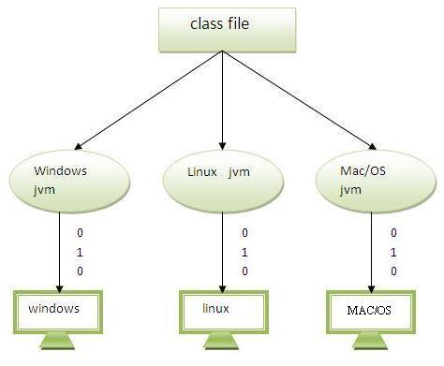

Slide 18
Robust
Robust simply means strong. Java uses strong memory management. There are lack of pointers that avoids security problem. There is automatic garbage collection in java. There is exception handling and type checking mechanism in java. All these points makes java robust.

Slide 19
Portable
We may carry the java byte code to any platform.

Slide 20
High-performance
Java is faster than traditional interpretation since byte code is "close“.

Slide 21
Distributed
We can create distributed applications in java.

Slide 22
Multi-threaded
A thread is like a separate program, executing concurrently. We can write Java programs that deal with many tasks at once by defining multiple threads. Threads are important for multi-media, Web applications etc.

